Slide 1
Analysis of Smart Lighting Systems
Xuerui Yan
Boyang Cai
Supervised by Prof. Mani Srivastava
EE M202B @UCLA

Slide 2
Problem Statement
Phenomenon of ever-lasting lighting at large-scale public buildings
Goal: Compare energy consumptions in large-scale public buildings among naive lighting control strategy, sensor mode control strategy, and data precontrol model strategy

Slide 3
Background of Methodology
Naive Lighting Control
Whatever Keep light ON
Sensor-mode Control
Once “1” raised in sensor, keep light ON for a constant time
Data Precontrol Model
Machine Learning based regression to predict light OFF waiting condition in different time intervals during a day

Slide 4
Data Precontrol Model (DPM) Frame
Mine the light ON/OFF (1/0) data of testing day(s) from smart sensors
Get non-linear regression of data by utilizing Machine learning algorithm
Obtain approximated function from regression, and do second derivative and definite integral to set different time intervals and their averaged light OFF waiting time (0->1), respectively
Output the predicted light power consumptions in the time intervals daily

Slide 5
Controllable Parameters in DPM Computation
Changeable data collection area for DPM computing
Regression degrees
Regularization Strength (alpha)
Normalization
Light OFF waiting threshold time
Customized light ON wait time for lighting comfort
Notes:
Fifth bullet point: in our testing case, 5min to predict the power consumption
We can control these parameters to get better performance of DPM

Slide 6
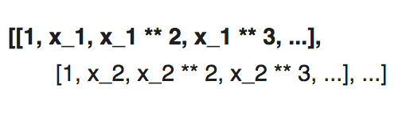
Machine Learning Regression Algorithm in DPM
Ridge Regression
From n data 1d points, it suffices to build the Vandermonde matrix, which is n data * n-th degree+1
Generated matrix can be interpreted as a matrix of pseudo features (the points raised to some power). The matrix is akin to (but different from) the matrix induced by a polynomial kernel
Notes:
Ridge solves a regression model where the loss function is the linear least squares function and regularization is given by the l2-norm.

Slide 7
Machine Learning Regression Algorithm in DPM
Polynomial Features
Generate a new feature matrix consisting of all polynomial combinations of the features with degree less than or equal to the required regressive degree.
Implement polynomial regression with a linear (Ridge) model, using a pipeline to add polynomial features.
Notes:
First bullet point: e.g. if input sample is two dimensional and of the form [a, b], the 2-degree polynomial features are [1, a, b, a^2, ab, b^2].

Slide 8
Energy Computation Algorithm in DPM
Compute the lighting energy consumption (Unit Watt * h) in different resulted time intervals obtained from regressive function
Base equation: Energy consumption = Energy_light_ON + Energy_light_setup
5-minute Rule[1] of light ON/OFF for setting Light OFF waiting threshold time
Rule 1: If you will be out of a room for 5 minutes or less, leave it on
Rule 2: If you will be out of a room for more than 5 minutes, turn it off.
Used for calculating setup energy cost of the light

Slide 9
Energy Computation Algorithm in DPM
Introduce light-OFF Probability
Ratio of sum of light OFF waiting time (0->1) above the waiting threshold time vs. the sum of total light OFF waiting time in one time interval
If Probability <= 0.6, execute Rule 1 (over-threshold waiting time not dominated)
tdMean average waiting time of the time interval obtained by integration from regressive equation to compute Energy_light_ON
occurTime the times of over-threshold waiting time to compute Energy_light_setup
If Probability > 0.6, execute Rule 2 (over-threshold waiting time dominated)
totalLightOffTime under this rule, light no longer waits threshold time, use total light OFF time instead of tdmean to compute Energy_light_ON
totalTime the total light ON/OFF time to compute Energy_light_setup
Punish the totalTime for more general prediction

Slide 10
Energy Computation Algorithm in DPM
Introduce light-OFF Probability

Slide 11
Energy Computation Algorithm in Naive and Sensor-mode Control
Naive Energy consumption = Energy_light_ON
Ignore Setup energy
Sensor-mode Energy consumption
LightOffTime the sum of light off time for over-threshold waiting time
Energy consumption = occurTime * setupEnergy + maintainPower * (deltaT - LightOffTime + occurTime * 5 * 60)

Slide 12
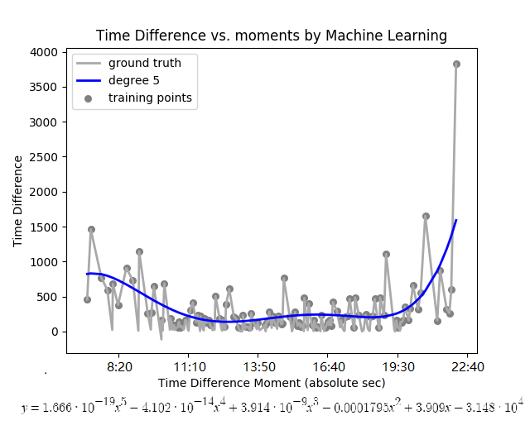
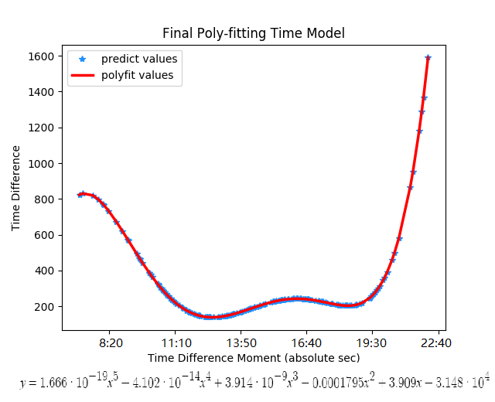
DPM Programming Output Validation Example
Weekday Area 1

Slide 13
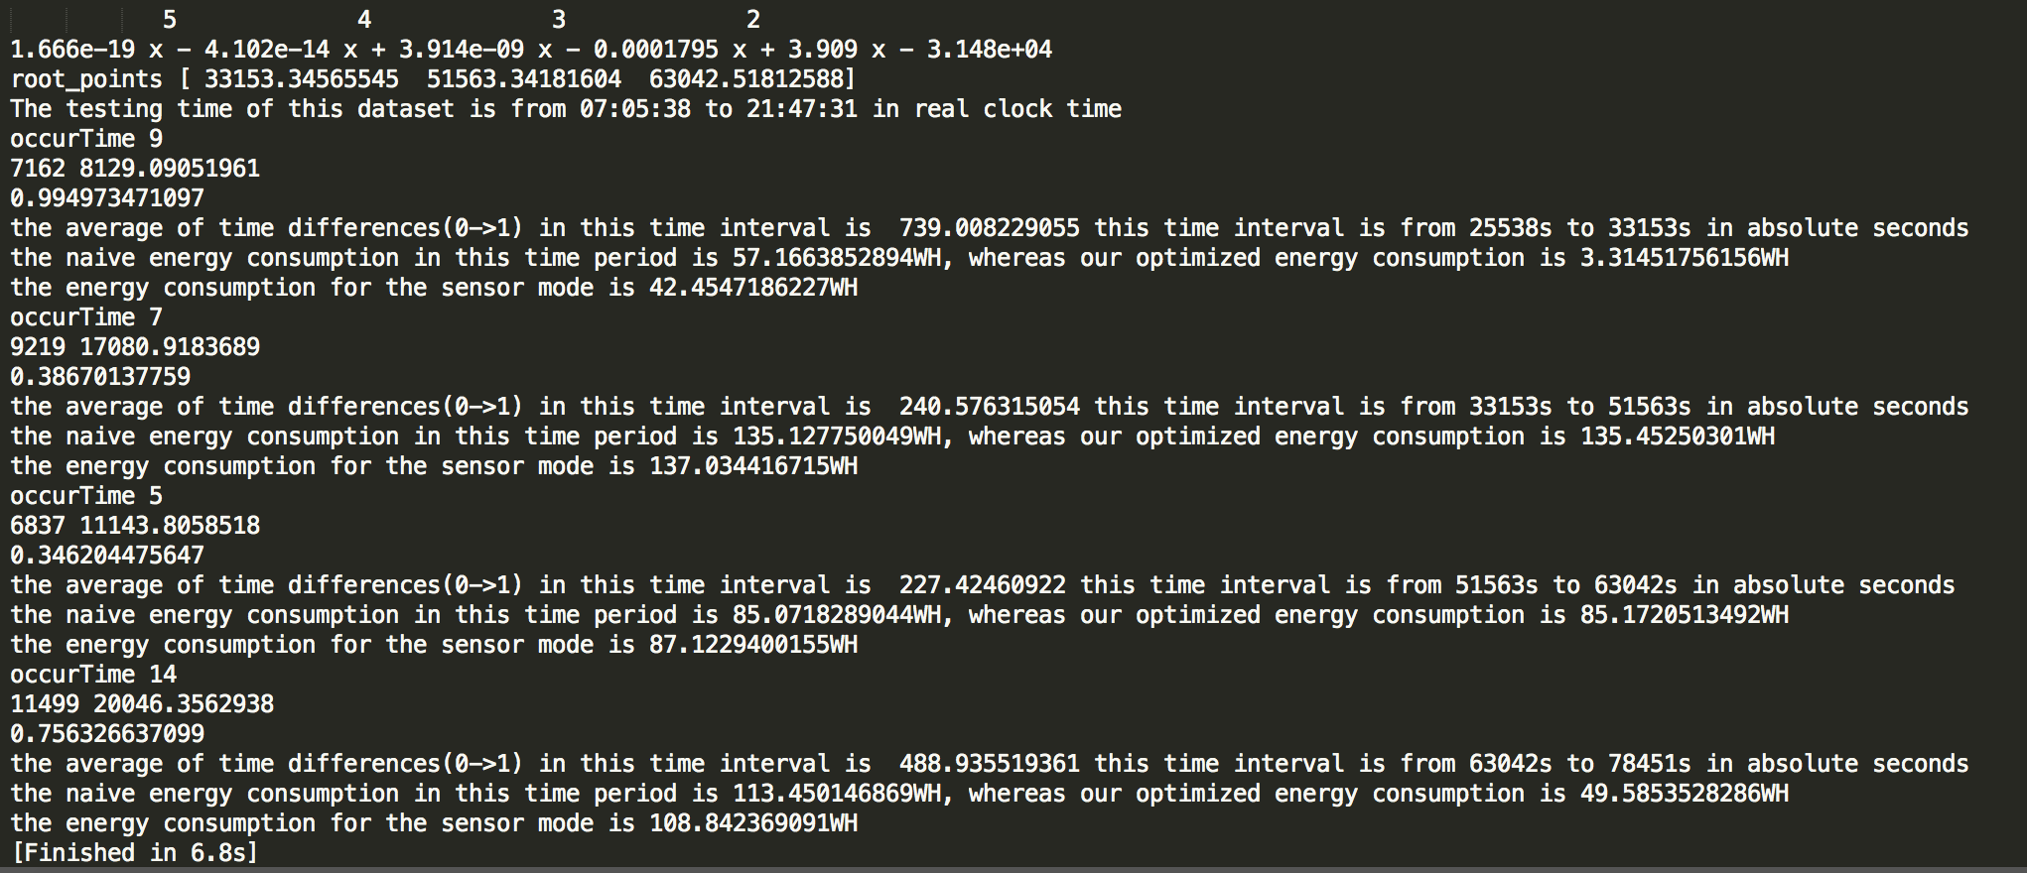
DPM Programming Output Validation Example
Weekday Area 1

Slide 14
Experimental Setup
Data collect place: UCLA Boelter Hall 4th Floor Hallway
Four testing areas along the hall, sensed by four motion sensors
Data collect time (7:00 - 23:00)
Weekday: different periods of days in one-week cycle
Weekend: different periods of days in three weekend days
Data collect period constrained by SEASnet Lab hours

Slide 15

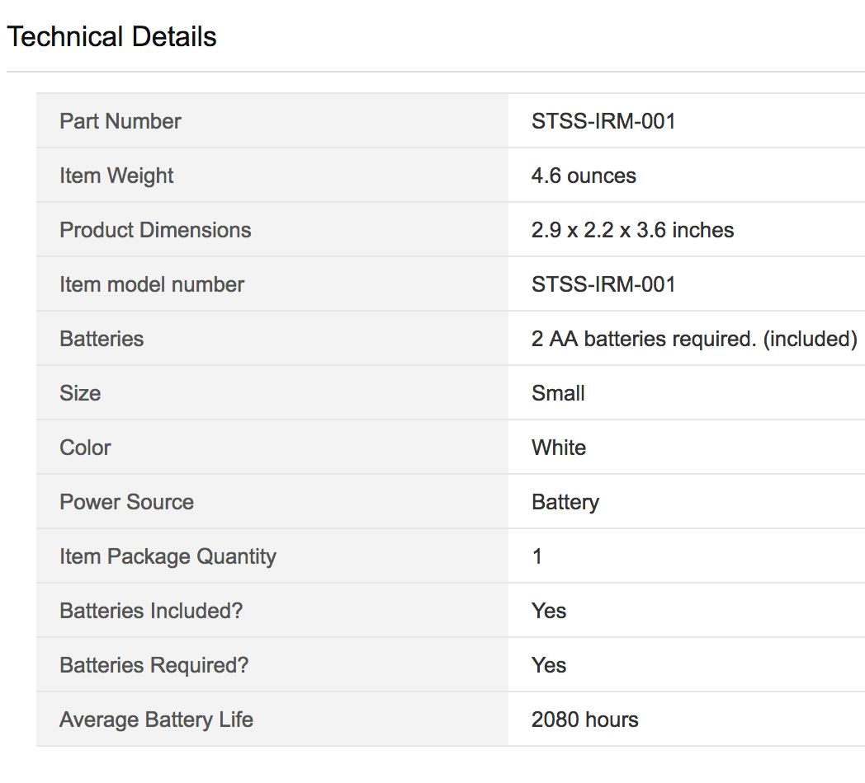

Experimental Setup
Equipments
Samsung SmartThings Hub x 1
SmartThings Motion Sensor x 4
TP-LINK Wi-Fi Access Point
Fluorescent Lights in Boelter Hall
26 Watts

Slide 16
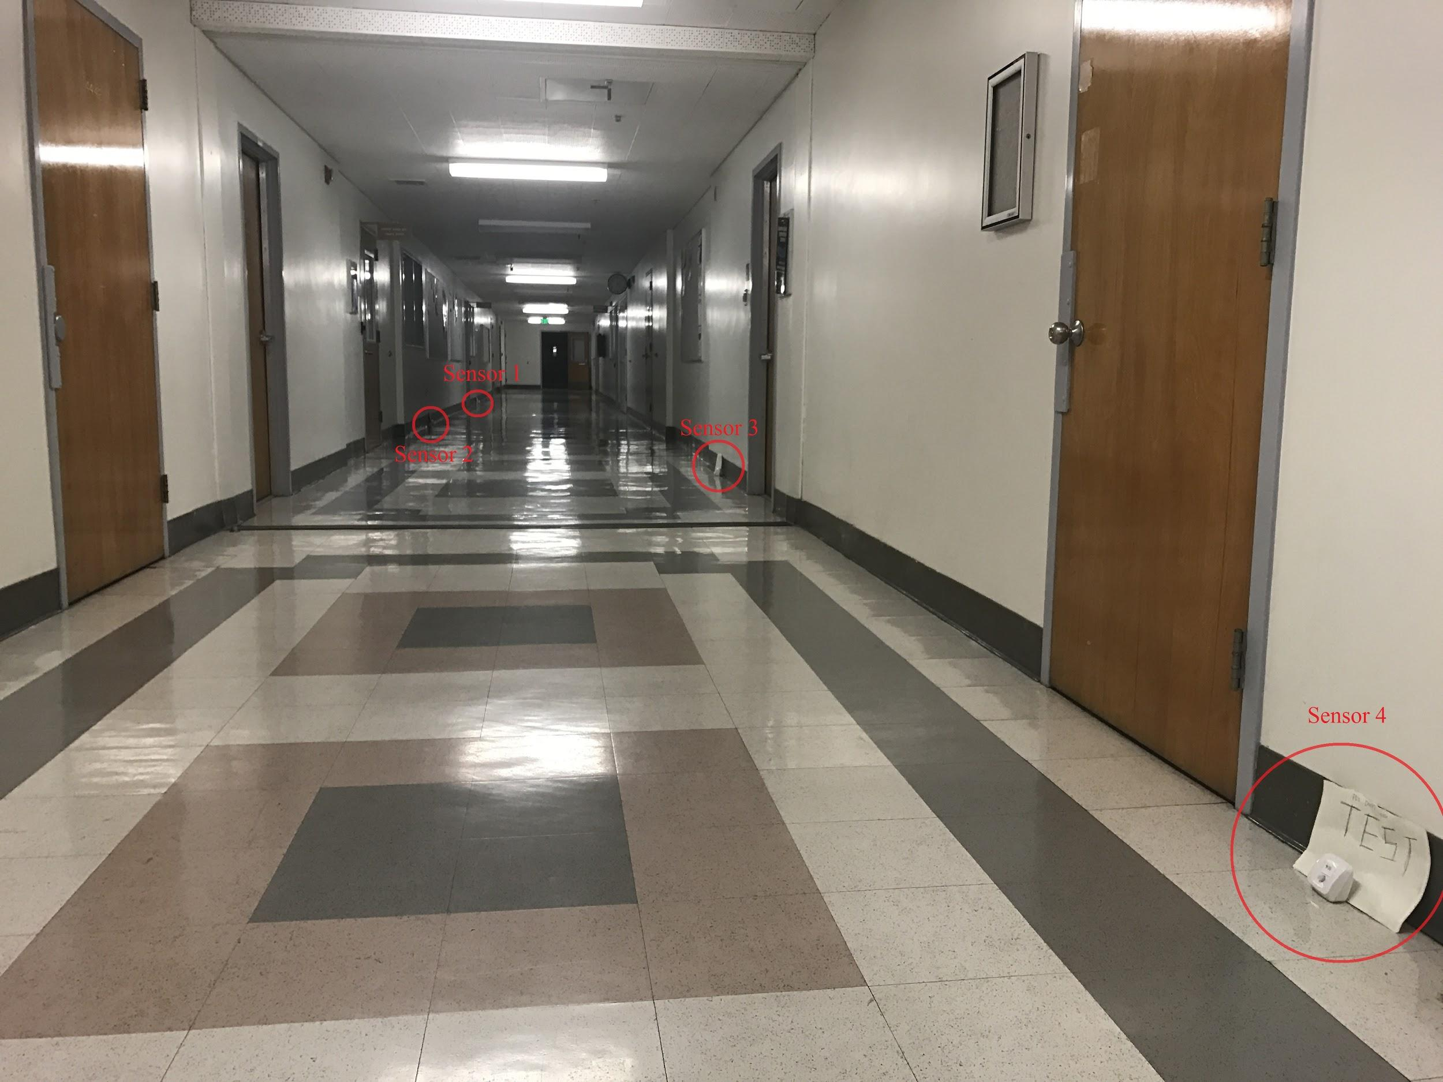
Experimental Setup

Slide 17
Brief Demonstration

Slide 18
Experimental Results
Better performance on Ridge Regression for Data Precontrol Model with our recorded data than other robust linear estimators[2]
RANSAC
TheilSen
OLS
Regression degrees for two data set
Weekday: 5th order quadratic equation
Weekend: 4th order quadratic equation
4th order Data more stable
Notes:
we have two data set
Weekday data and Weekend data

Slide 19
Experimental Results
Weekday Area 1

Slide 20
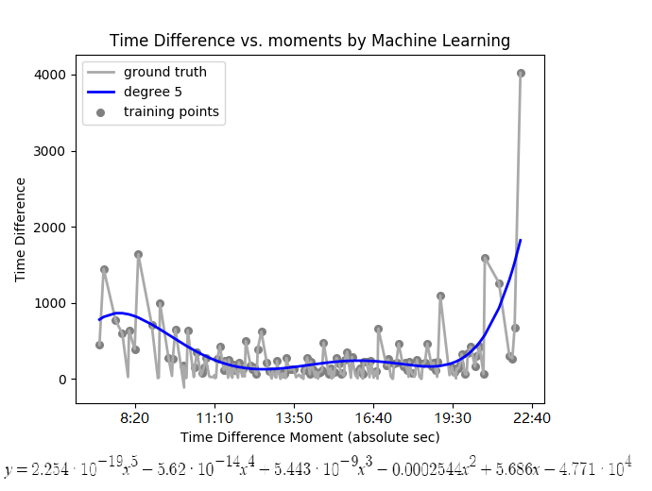
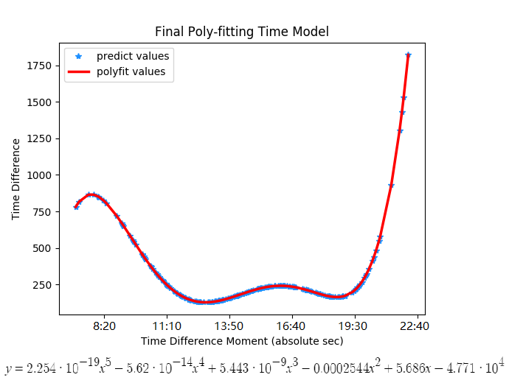
Experimental Results
Weekday Area 2

Slide 21
Experimental Results
Comparison among three strategies
weekday
 | Area 1 |  |  |  | Area 2
Sensor Mode Type | Period | Sensor Mode | Naive | Data Precontrol Model | Period | Sensor Mode | Naive | Data Precontrol Model
 | 7:05:38 | 42.45 | 57.17 | 3.31 | 7:05:38 | 47.35 | 65.81 | 7.11
 | 9:12:33 | 137.03 | 135.13 | 135.45 | 9:32:30 | 129.69 | 127.98 | 128.51
 | 14:19:23 | 87.12 | 85.07 | 85.17 | 14:22:51 | 87.19 | 86.60 | 86.30
 | 17:30:42 | 108.84 | 113.45 | 49.59 | 17:37:42 | 103.89 | 110.75 | 60.96
Total Energy(WH) |  | 375.45 | 390.82 | 273.52 |  | 368.12 | 391.14 | 282.88

Slide 22
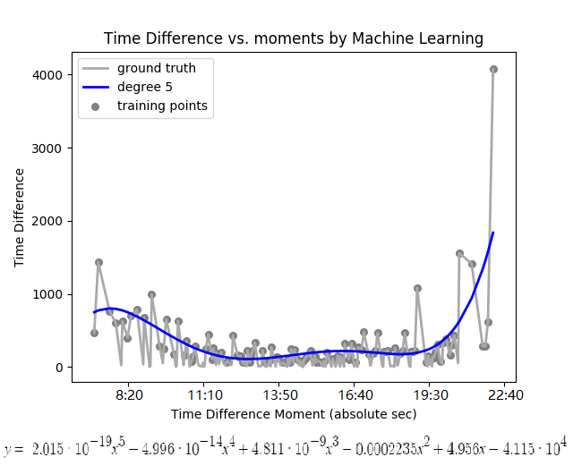
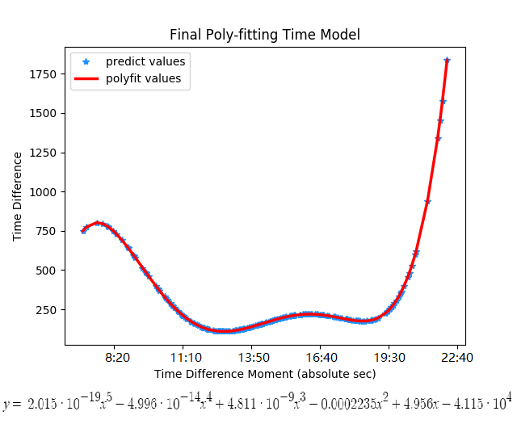
Experimental Results
Weekday Area 3

Slide 23
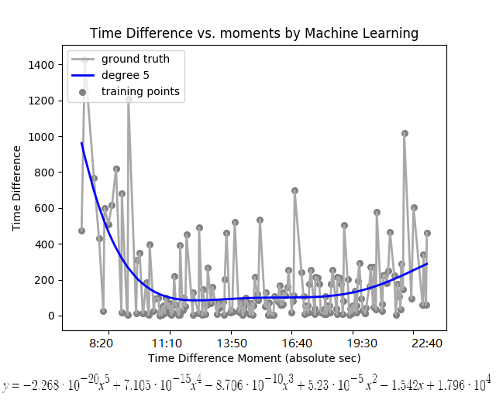
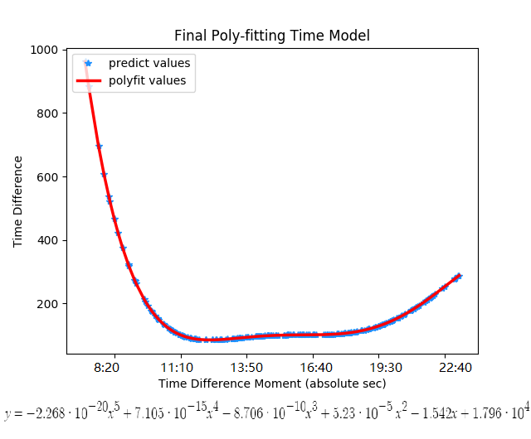
Experimental Results
Weekday Area 4

Slide 24
Experimental Results
Comparison among three strategies
weekday
 | Area 3 |  |  |  | Area 4
Sensor Mode Type | Period | Sensor Mode | Naive | Data Precontrol Model | Period | Sensor Mode | Naive | Data Precontrol Model
 | 7:05:38 | 50.54 | 63.43 | 6.95 | 7:05:38 | 165.74 | 170.69 | 108.04
 | 9:26:59 | 132.75 | 130.15 | 131.24 | 13:34:32 | 72.50 | 72.94 | 74.86
 | 14:22:20 | 85.81 | 83.49 | 83.04 | 16:17:52 | 154.64 | 159.28 | 163.26
 | 17:30:00 | 103.88 | 114.13 | 68.13 | 22:20:26 | 14.82 | 15.14 | 12.18
Total Energy(WH) |  | 372.98 | 391.19 | 289.35 |  | 407.70 | 418.06 | 358.33

Slide 25
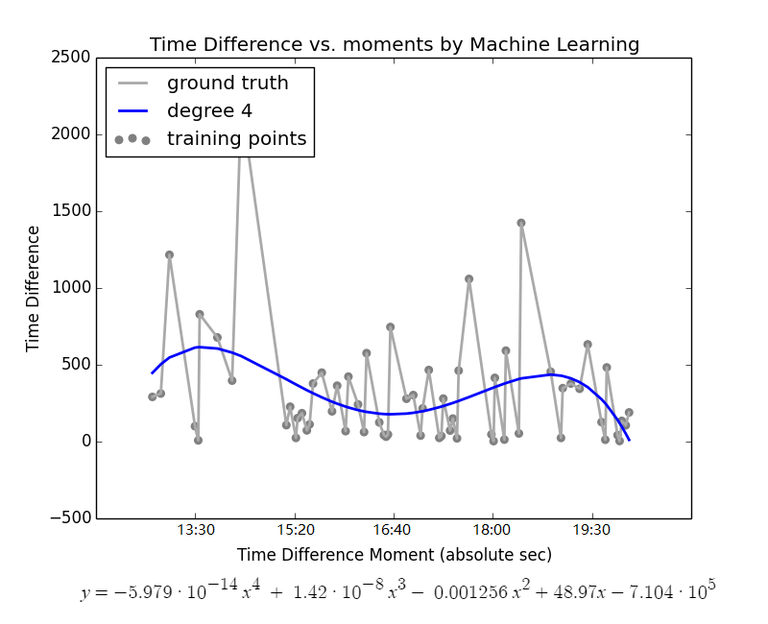
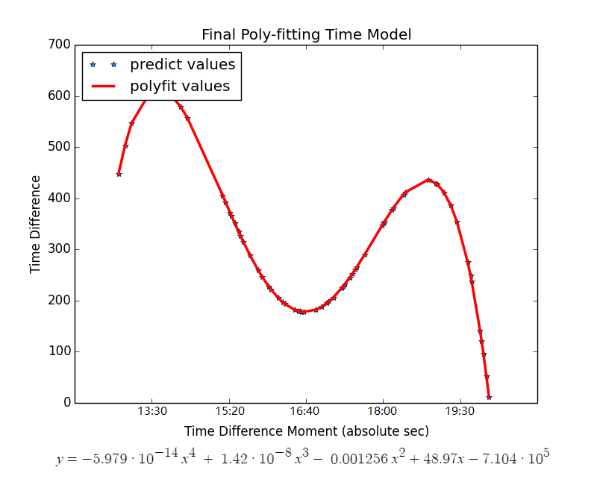
Experimental Results
Weekend Area 1

Slide 26
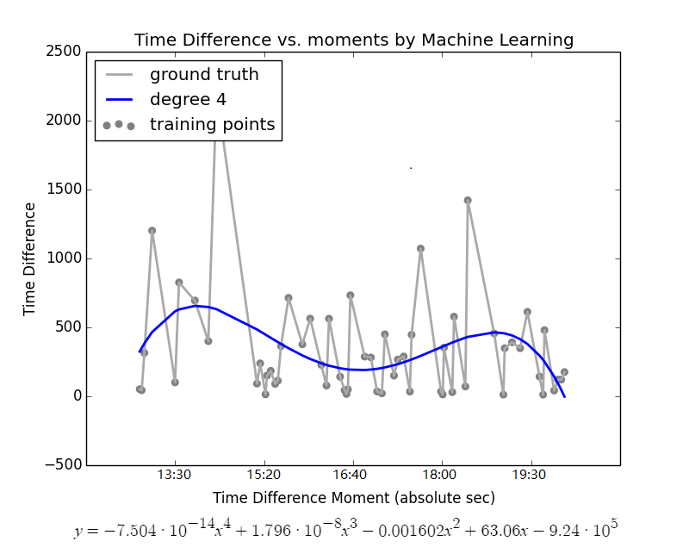
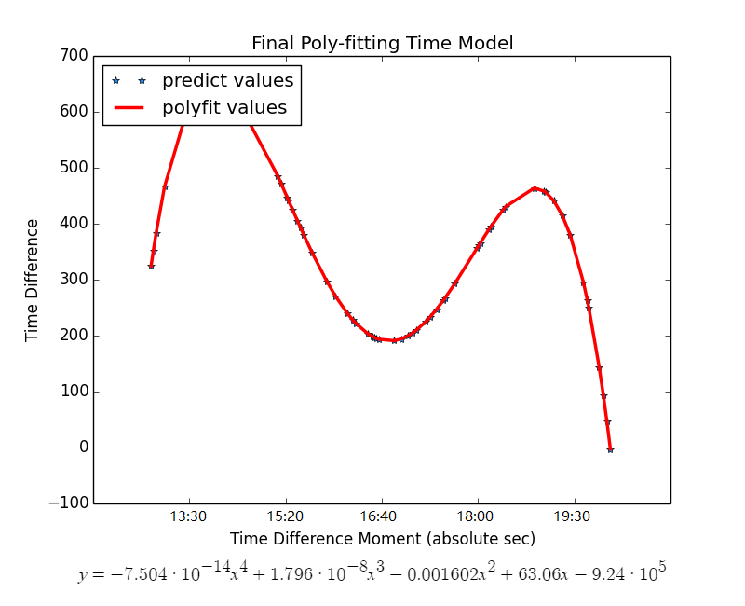
Experimental Results
Weekend Area 2

Slide 27
Experimental Results
Comparison among three strategies
weekend
 | Area 1 |  |  |  | Area 2
Sensor Model Type | Period | Sensor Model | Naive | Data Precontrol Model | Period | Sensor Model | Naive | Data Precontrol Model
 | 13:17:22 | 32.18 | 49.16 | 4.59 | 13:20:11 | 35.76 | 52.80 | 7.99
 | 15:05:48 | 77.97 | 74.79 | 40.10 | 15:17:02 | 70.28 | 71.81 | 32.76
 | 17:53:24 | 56.14 | 56.08 | 17.40 | 17:57:45 | 54.89 | 54.24 | 15.97
Total Energy(WH) |  | 166.28 | 180.03 | 62.08 |  | 160.93 | 178.86 | 56.71

Slide 28
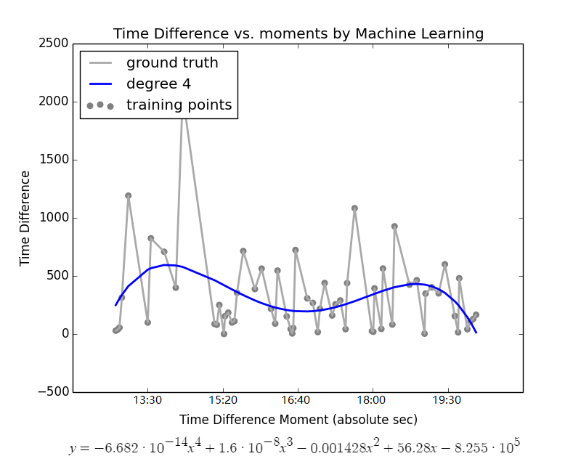
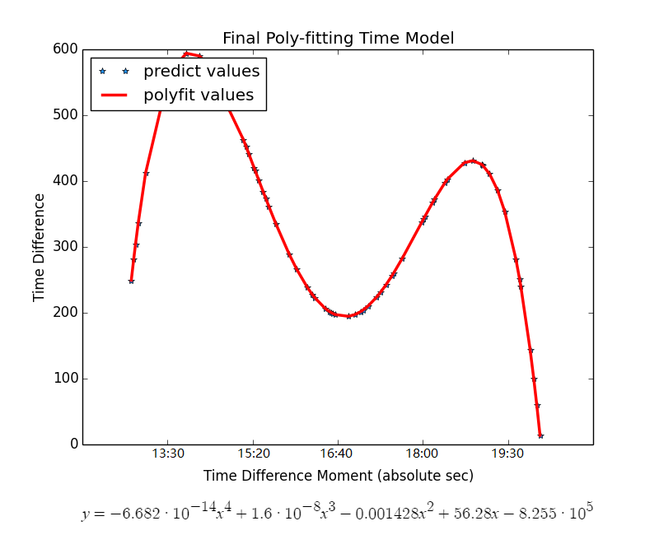
Experimental Results
Weekend Area 3

Slide 29

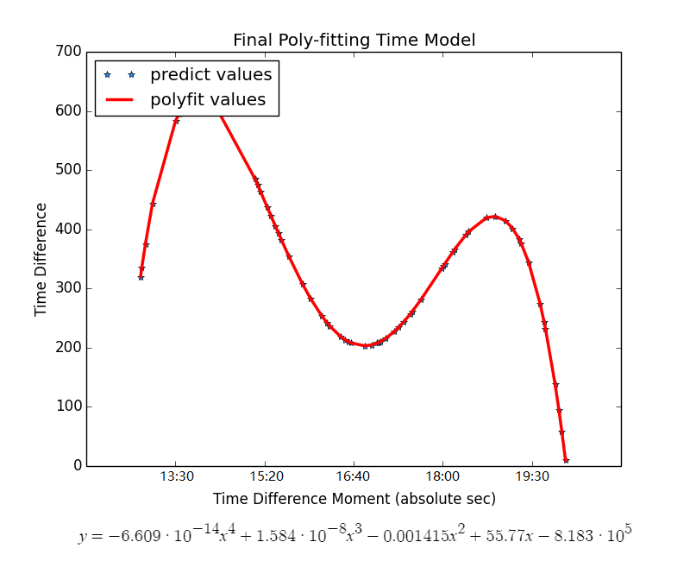
Experimental Results
Weekend Area 4

Slide 30
Experimental Results
Comparison among three strategies
weekend
 | Area 3 |  |  |  | Area 4
Sensor Mode Type | Period | Sensor Mode | Naive | Data Precontrol Model | Period | Sensor Mode | Naive | Data Precontrol Model
 | 13:17:53 | 38.42 | 54.36 | 10.96 | 13:20:45 | 35.41 | 53.32 | 11.22
 | 15:18:19 | 72.12 | 71.27 | 29.20 | 15:18:48 | 72.43 | 71.36 | 29.54
 | 17:57:46 | 59.53 | 54.28 | 16.54 | 17:58:28 | 60.41 | 54.01 | 17.54
Total Energy(WH) |  | 170.08 | 179.90 | 56.70 |  | 168.26 | 178.69 | 58.30

Slide 31
Conclusion
The result shows that Data Precontrol Model has a significant drop compared to the Naive model
The Data Precontrol Model also have a benefit compared to the Sensor Mode
However, Data Precontrol Model required more hardware equipment and maintenance than the Naive mode and Sensor more
Need maintain on the machine learning server
Sensor maintenances.

Slide 32
Future Work
Getting more daily data to be iteratively computed in DPM
More daytime data
Fill Midnight data (0:00 - 6:00am)
Add more features in machine learning model
E.g. Temperature, Schedules of office/class hours in the testing floor
Measure the real power consumption of fluorescent light with physical devices
Change better smart sensors with faster reaction and LED for better energy saving
Expand the sensing area (use long distance sensor) to cover and manage more different areas

Slide 33
Future Work
Currently only use the SmartThings related devices to sense and transmit data for validation purpose
In the future we can use microcontroller to replace the SmartThings Hub
cost vs complexity

Slide 34
Reference
[1] “Does Turning Fluorescent Lights Off Use More Energy Than Leaving Them On?”. Retrieved from: https://www.scientificamerican.com/article/turn-fluorescent-lights-off-when-you-leave-room/
[2] “Robust linear estimator fitting”. Retrieved from: http://scikit-learn.org/stable/auto_examples/linear_model/plot_robust_fit.html#sphx-glr-auto-examples-linear-model-plot-robust-fit-py
[3] “Code reference for logging data to google sheet” https://community.smartthings.com/t/log-events-to-google-sheets-see-post-154-for-current-github-repo-and-v1-1/36719

